Slide 1
Design of RF & Microwave Systems
EEC 134 A&B
Lecture 8: Passive Components
Xiaoguang “Leo” Liu
Associate Professor
School of Electrical and Computer Engineering
Tel: 530-289-6367
lxgliu@ucdavis.edu
http://dart.ece.ucdavis.edu

Slide 2
Power Splitters and Power Combiners
In high frequency circuits, you cannot arbitrarily split signals
50 Ω
50 Ω
50 Ω
50 Ω
P₁=?
P_{in}
50 Ω
50 Ω
P₂=?

Slide 3
Power Splitters and Power Combiners
So what is the proper way to split RF signals?
100 Ω
50 Ω
50 Ω
100 Ω
P_{in}
100 Ω
100 Ω
But we want to deliver the power to 50 Ω load !

Slide 4
Power Splitters and Power Combiners
Impedance Matching
100 Ω
50 Ω
50 Ω
50 Ω
P_{in}
100 Ω
Impedance Matching
50 Ω

Slide 5
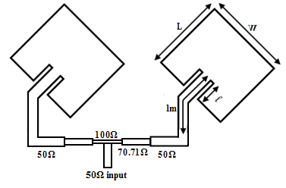
Power Splitters and Power Combiners
T-junction splitter
There is no isolation between the two split ports
70.7 Ω, λ/4
100 Ω
50 Ω
50 Ω
50 Ω
?
P_{in}
70.7 Ω, λ/4
100 Ω
50 Ω
Example: T-junction fed microstrip antenna array;
T-junctions can be cascaded to make 1:2^{N} dividers
Notes:
Discuss the adverse effect of un-matched split ports

Slide 6
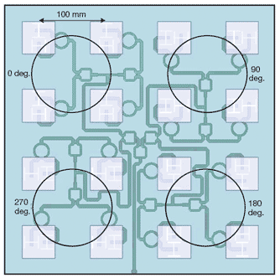
Wilkinson Power Divider
Matched at all three ports
Lossless power divider
70.7 Ω, λ/4
50 Ω
50 Ω
50 Ω
100 Ω
P_{in}
70.7 Ω, λ/4
50 Ω
Example: 16-element microstrip antenna array fed by 4-level Wilkinson power divider

Slide 7
Wilkinson Power Divider
But a (most of the time) lossy combiner
70.7 Ω, λ/4
50 Ω
50 Ω
50 Ω
100 Ω
?
70.7 Ω, λ/4
50 Ω
P_{in}

Slide 8
Wilkinson Power Divider
Only lossless when P_{in1} and P_{in2} are coherent and in-phase
70.7 Ω, λ/4
50 Ω
50 Ω
P_{in1}
100 Ω
?
70.7 Ω, λ/4
P_{in2}

Slide 9
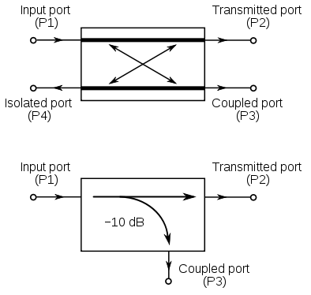
3-dB Hybrid (3-dB Coupler)
Another way to split high frequency power is to use a hybrid
The two outputs of a Wilkinson power divider are in phase
A 3-dB hybrid splits power with a phase difference

Slide 10
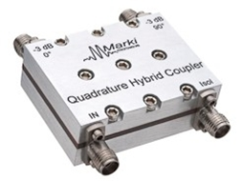
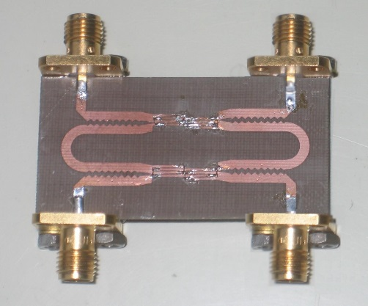
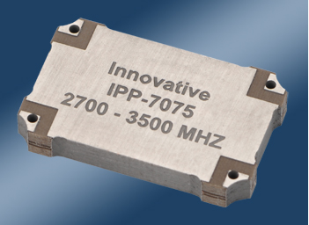



90⁰ Hybrid
Sometime also called quadrature hybrid
Can be used to generate a pair of sine and cosine waves from a cosine (or sine) wave; the significance of this will be discussed in future lectures
Can be found in many forms
$$\frac{1}{\sqrt{2}}V_{in}/−90⁰$$
$$V_{in}$$
$$\frac{1}{\sqrt{2}}V_{in}/−180⁰$$
Notes:
http://www.markimicrowave.com/Couplers/3_dB_Quadrature_90_degree_Hybrids/QH-0440.aspx
http://www.ihf.uni-stuttgart.de/forschung/forschungsgebiete/uwb/index.en.html
http://innovativepp.com/surface-mount-90-degree-hybrid-coupler/

Slide 11
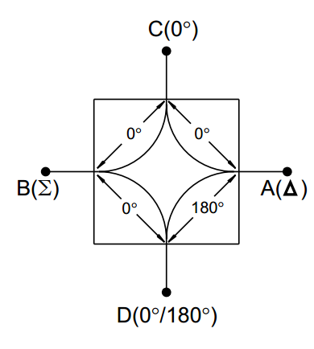
180⁰ Hybrid
Can split power equally into two in-phase signals
Can also split power equally into two out-of-phase signals
Can be used to generate differential signal pairs
Can be used to generate sum and difference of two high frequency signals

Slide 12



180⁰ Hybrid
Can split power equally into two in-phase signals
Can also split power equally into two out-of-phase signals
Can be used to generate differential signal pairs
Can be used to generate sum and difference of two high frequency signals
$$V_{in}$$
$$\frac{1}{\sqrt{2}}V_{in}$$
$$\frac{1}{\sqrt{2}}V_{in}$$

Slide 13



180⁰ Hybrid
Can split power equally into two in-phase signals
Can also split power equally into two out-of-phase signals
Can be used to generate differential signal pairs
Can be used to generate sum and difference of two high frequency signals
$$\frac{1}{\sqrt{2}}V_{in}$$
$$V_{in}$$
$$\frac{1}{\sqrt{2}}V_{in}$$

Slide 14

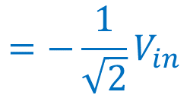


180⁰ Hybrid
Can split power equally into two in-phase signals
Can also split power equally into two out-of-phase signals
Can be used to generate differential signal pairs
Can be used to generate sum and difference of two high frequency signals
$$\frac{1}{\sqrt{2}}V_{in}$$
$$\frac{1}{\sqrt{2}}V_{in}/{180}^{0}$$
$$=−\frac{1}{\sqrt{2}}V_{in}$$
$$V_{in}$$

Slide 15




180⁰ Hybrid
Can split power equally into two in-phase signals
Can also split power equally into two out-of-phase signals
Can be used to generate differential signal pairs
Can be used to generate sum and difference of two high frequency signals
$$\frac{1}{\sqrt{2}}V_{in}$$
$$V_{in}$$
$$\frac{1}{\sqrt{2}}V_{in}/{180}^{0}$$
$$=−\frac{1}{\sqrt{2}}V_{in}$$

Slide 16




180⁰ Hybrid
Can split power equally into two in-phase signals
Can also split power equally into two out-of-phase signals
Can be used to generate differential signal pairs
Can be used to generate sum and difference of two high frequency signals
$$V_{1}$$
$$\frac{1}{\sqrt{2}}V_{1}+\frac{1}{\sqrt{2}}V_{2}$$
$$\frac{1}{\sqrt{2}}V_{1}−\frac{1}{\sqrt{2}}V_{2}$$
$$V_{2}$$

Slide 17
Couplers
The 90⁰ and 180⁰ hybrids are special kind of a broader range of devices called couplers
If the coupling ratio is 3-dB, then they are usually called hybrids
Coupling ratio
Notes:
Need photos of actual 180 hybrids

Slide 18
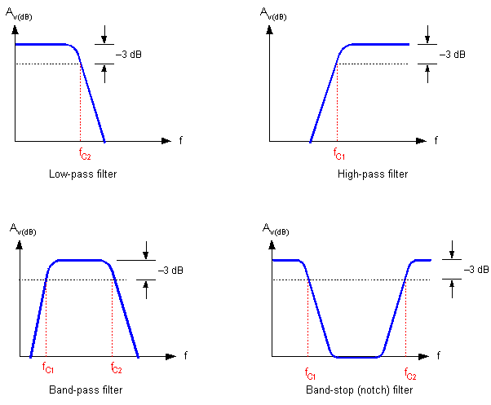
Filters
Allow some signals to pass while rejecting others (in most cases)
Types of filters
Lowpass Filter
Highpass Filter
Bandpass Filter
Bandstop (Notch) Filter

Slide 19
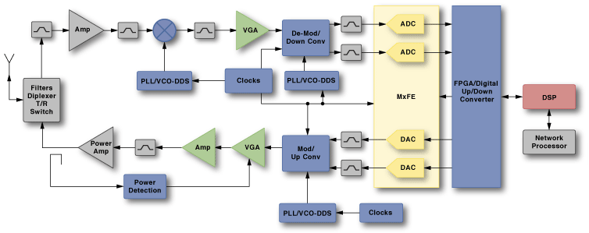
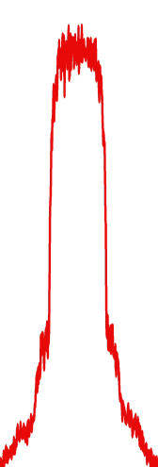
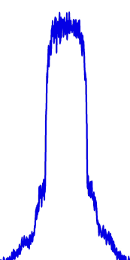

Filters
Band select
Image rejection
Elimination of
spurious signals
Power
Frequency

Slide 20
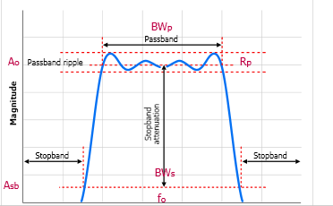
Filters
Specifications
Insertion loss (IL)
Filter shape
http://e2e.ti.com/support/development_tools/webench_design_center/f/399/t/87122.aspx

Slide 21
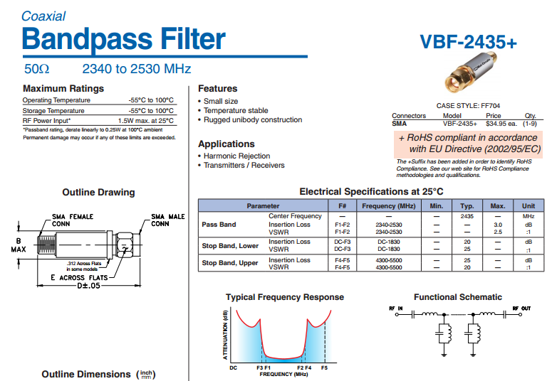
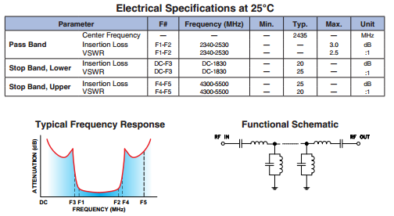
Filters

Slide 22
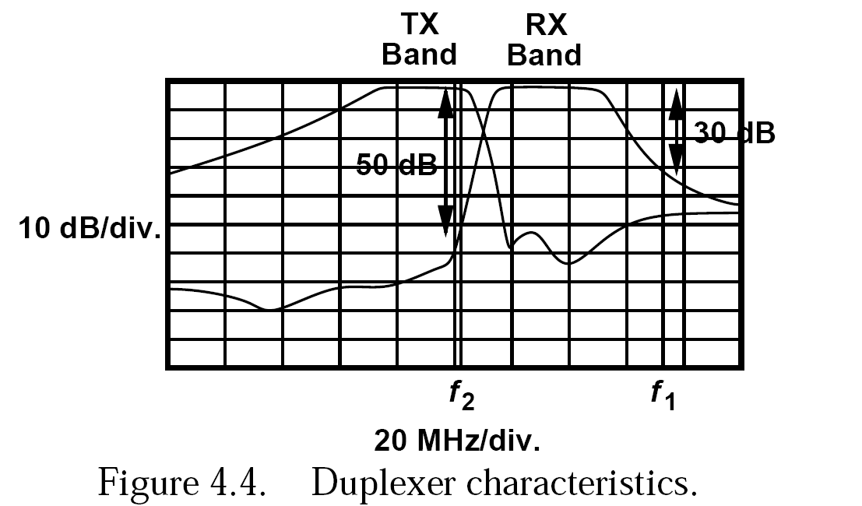
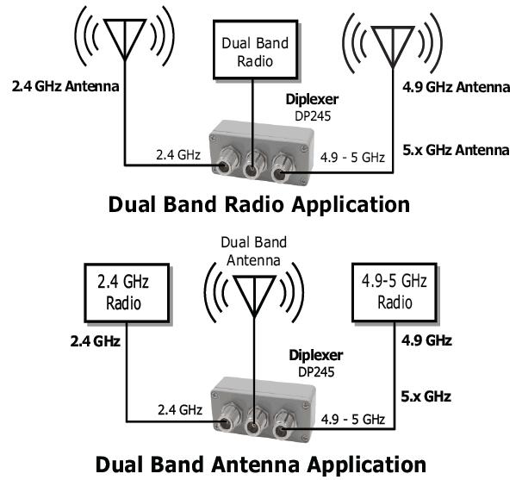
Diplexer
Special kind of filter combination that allow separation of frequencies
The front-end band-select filter (diplexer) suffers from a trade-off between its selectivity and its in-band insertion loss.

Slide 23
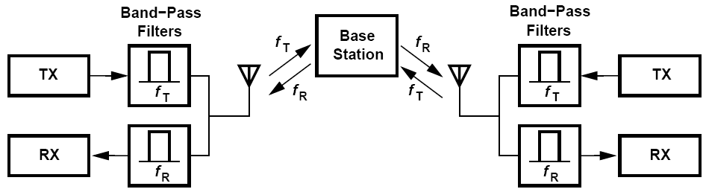
Frequency Division Duplexing (FDD)
Two frequency bands for transmit and receive
Mobile Station
Mobile Station

Slide 24
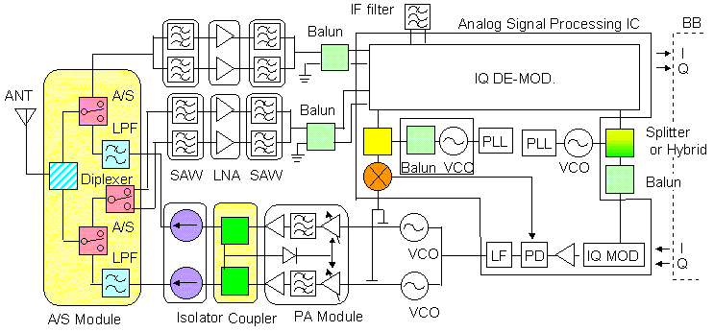
GSM Example
A diplexer is the simplest form of a multiplexer, which can split signals from one common port into many different paths. Signals are often separated by frequency.

Slide 25
Diplexer and Duplexer
Duplexer is a device that enables duplexing, i.e. transmit and receive simultaneously
Diplexer often refers to a device that directs signals of different frequencies to different paths
Diplexer can be used as a Duplexer

Slide 26
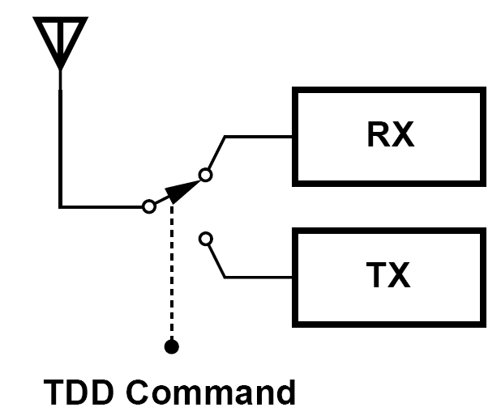
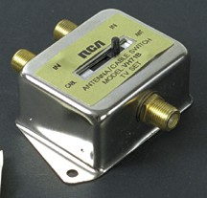
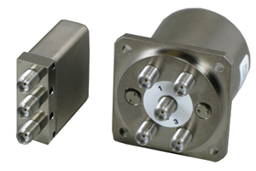
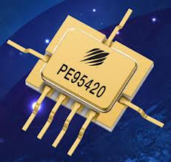
Time Division Duplexing (TDD)
Transmit and receive separated in time
T/R Switch

Slide 27
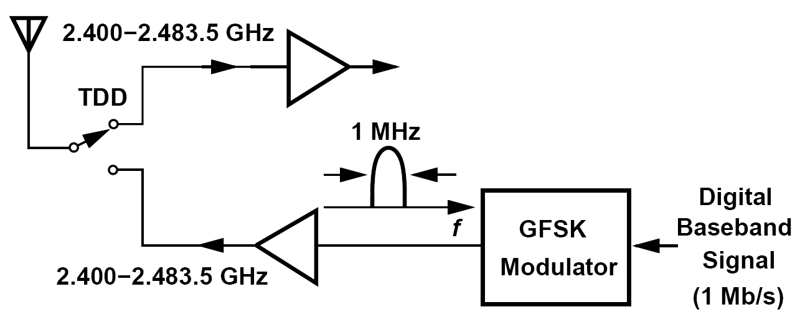
Example: Bluetooth
Bluetooth: 2.4-GHz ISM band. Each channel carries 1 Mb/s, occupies 1 MHz

Slide 28
FDD vs. TDD
FDD: spectral leakage to adjacent channels in the transmitter output; part of the transmitted signal that leak into the receive band are attenuated by typically only about 50 dB maximum)
FDD: owing to the trade-off between the loss and the quality factor of filters, the loss of the duplexer is typically quite higher than that of a TDD switch.

Slide 29
FDD vs. TDD
TDD: two paths (RX,TX) do not interfere because the transmitter is turned off during reception
TDD: strong signals generated by all of the nearby mobile transmitters fall in the receive band, thus desensitizing the receiver.

Slide 30
FDD vs. TDD
FDD is best suited for applications, such as voice, that generate symmetric traffic, while TDD is best suited for bursty, asymmetric traffic, such as Internet or other data centric services
In TDD, both the transmitter and receiver operate on the same frequency but at different times. Therefore, TDD systems reuse the filters, mixers, frequency sources and synthesizers, therefore reducing the complexity and cost of the system.
TDD utilizes the spectrum more efficiently than FDD

Slide 31
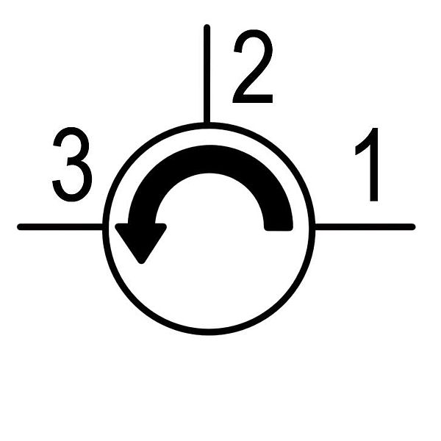
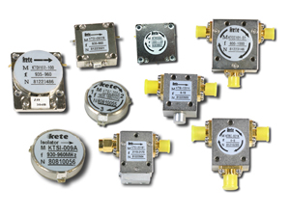
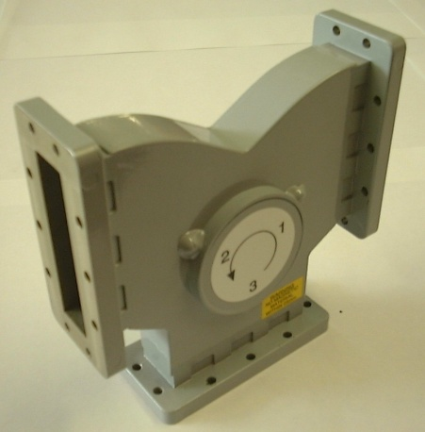
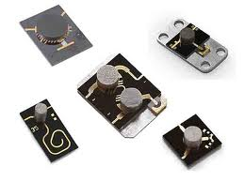
Circulator
A passive non-reciprocal three- or four-port device, in which a microwave or RF signal entering any port is transmitted to the next port in rotation (only).
Isolation is important

Slide 32
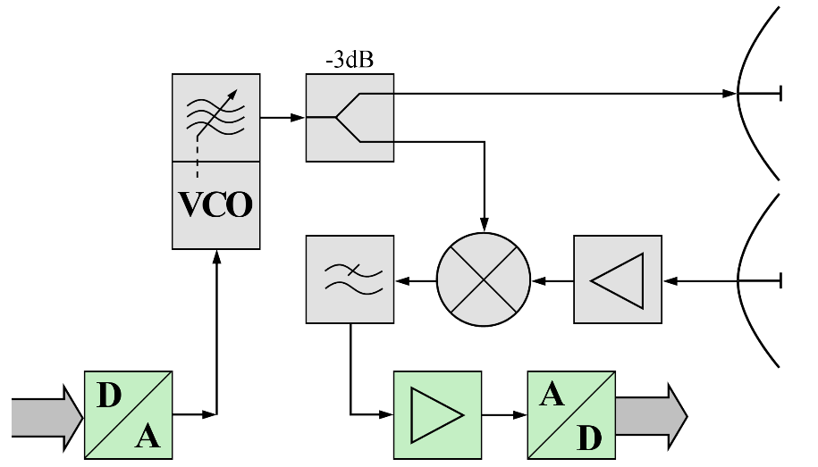
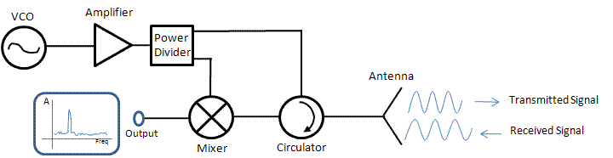
Use Circulator in Radar Systems
Two antennas
One antenna
Circulator

